Slide 1
PROJECT NAME
Mental Health Companion Chatbot
CAPSTONE PROJECT
PRESENTED BY : AADITHYA
COLLEGE NAME : BHARATH INSTITUTE OF HIGHER EDUCATION AND RESEARCH
DEPARTMENT : CSE (AIML)

Slide 2
OUTLINE
Problem Statement (Should not include solution)
Proposed System/Solution
System Development Approach (Technology Used)
Algorithm & Deployment
Result
Conclusion
Future Scope
References

Slide 3
Problem Statement
.
Mental health issues such as stress, anxiety, and depression are increasing rapidly due to academic pressure, work stress, and lifestyle changes.
Many individuals do not seek professional help because of social stigma, high consultation costs, and lack of immediate access to mental health professionals.
Traditional mental health support systems are not always available 24/7 and may not provide instant assistance.
Therefore, there is a need for an accessible, cost-effective, and always-available system that can provide basic mental health support and guidance.

Slide 4
Proposed Solution
The proposed system is a Mental Health Companion Chatbot that provides emotional support through interactive conversation.
The chatbot allows users to express their feelings and concerns in a safe and non-judgmental environment.
It analyzes user input and provides supportive responses, stress management suggestions, and mental wellness guidance.
The system is designed to be available 24/7 and can serve as a first-level support tool for individuals seeking mental health assistance.

Slide 5
System Approach
Programming Language: Python
Chatbot Type: AI-based Conversational System
Libraries Used: Streamlit, NLP Libraries
Deployment Platform: Streamlit Community Cloud
Version Control: GitHub

Slide 6
Algorithm & Deployment
Algorithm:
Natural Language Processing (NLP) techniques are used to understand and interpret user messages.
The chatbot processes user input, identifies keywords and emotional cues, and generates appropriate responses.
This enables meaningful and context-aware conversations that support user mental well-being.
Deployment:
The chatbot is developed as a web application using Streamlit.
After development, the application is deployed on Streamlit Community Cloud.
Deployment through cloud hosting allows the chatbot to be accessed from anywhere using a web browser without requiring local installation.
.

Slide 7
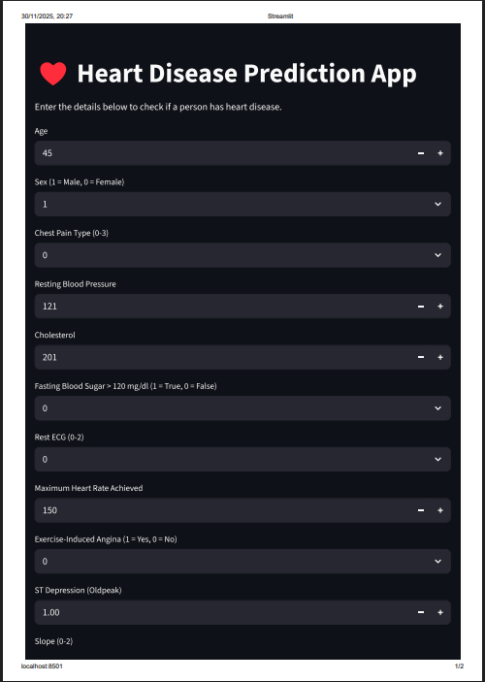
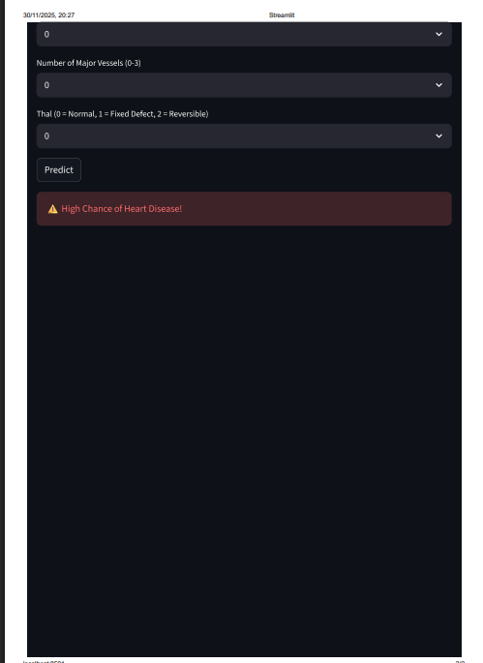
Result

Slide 8
Conclusion
The Mental Health Companion Chatbot demonstrates the practical application of artificial intelligence in the field of mental health support.
The system provides an accessible, user-friendly, and supportive platform for individuals seeking emotional assistance.
By combining NLP techniques with a web-based interface, the project highlights how technology can be used to promote mental well-being.
This project serves as a foundation for more advanced mental health support systems in the future.

Slide 9
Future scope
The chatbot can be enhanced by integrating advanced emotion detection techniques to better understand user feelings.
Multilingual support can be added to make the system accessible to a wider audience.
The system can be integrated with professional counseling services for emergency or high-risk cases.
A mobile application version can be developed to improve accessibility and user engagement.
Machine learning models can be improved to provide more personalized mental health recommendations.
.

Slide 10
References
Hugging Face – The AI community building the future.
Streamlit • A faster way to build and share data apps
Welcome to Python.org
1. Supervised learning — scikit-learn 1.8.0 documentation

Slide 11
Github link
Github Link : https://github.com/kiranaadhi6677-web/heart-disease-streamlit.git
Deployment Link: https://heart-disease-app-gfdpmcovnorzcplo8mgc6g.streamlit.app/

Slide 12
THANK YOU

